Slide 1
K-mean limitations
Presented by : Ravikumar Panchal

Slide 2
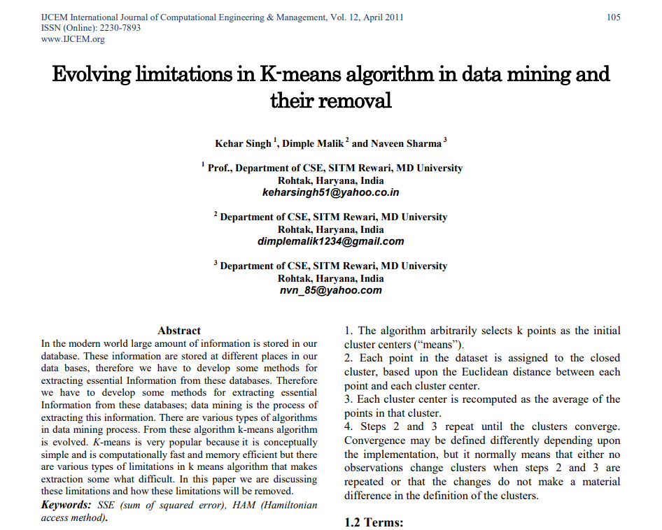

Slide 3
Research Article
Title
Evolving limitations in K-means algorithm in data mining and their removal
Purpose
Identify the limitations of K means and provide their solutions

Slide 4


Flow of the Presentation
Understanding K-means and its use
Exploring key terms
Steps in K-means algorithm
Disadvantages of K-means
Limitations of K-means
Prepositions

Slide 5
K Means
Known for its simple and efficient clustering of a large dataset
Used widely to segment large datasets e.g.,
Customer segmentation,
Document categorization,
Anomaly detection, image segmentation,
Sentimental analysis, and many more
However, K means has various limitations too!

Slide 6
Key Terms
Before moving on let’s understand the key terms!
K-means Clustering – cluster analysis method to partition n observations into k clusters where each observation belongs to the cluster with the nearest mean
Threshold – The lowest possible input value of similarity required to join two objects in one cluster.
Cluster Seed – the first object of a cluster is defined as the initiator of that cluster in which the initiator is called the cluster seed.

Slide 7
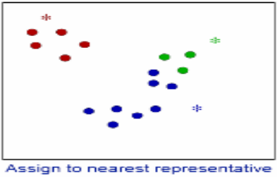
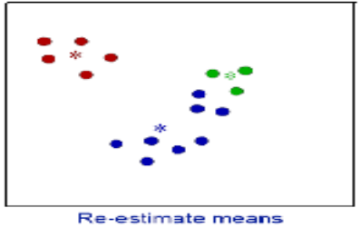
Example of an indicator of the distance of the n data points from their respective cluster centers.

Slide 8
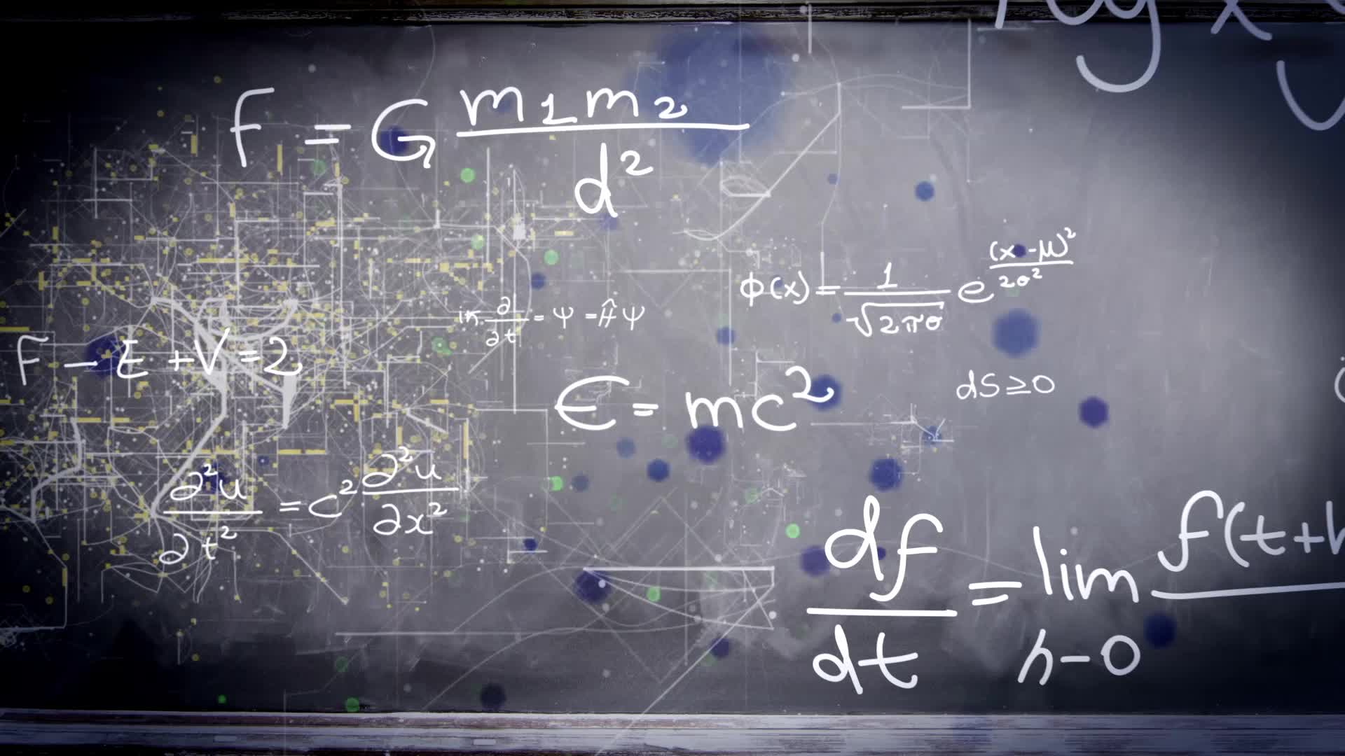
Steps in k means algorithm
3 Main Steps:
Assignment step: Assign each observation to the cluster with the closest mean
Update step: Calculate the new means to be the centroid of the observations in the cluster
Complexity: of k means algorithm is given

Slide 9
K Means Disadvantages
Do not provide the same results in each run
Minimizes intra-cluster variance
Do not indicate results’ global minimum of variance
Requirements to define the concept of a mean

Slide 10
K Means Limitation
Handling Empty Clusters
Outliers
Reducing SSE (Sum of Squared Error) with Post Processing
Difficult to measure number of clusters

Slide 11
Limitation: Handling Empty Clusters
Empty cluster is acquired IF no points are assigned at the assignment stage
Empty clusters cause to have a larger squared error
It can also cause;
Misinterpretation of data
Inconsistent cluster outcomes
Underutilized information, etc.

Slide 12

How to handle an empty cluster?
Choose the farthest point from any current centroid
This will eliminate that contributes to the total squared error
Choose the replacement centroid from the cluster with the highest SSE
This will split the cluster and reduce the overall SSE of the clustering
Repeat the process as needed ( when several clusters are present)

Slide 13
Limitation: Outliers
Presence of outliers resulting in cluster prototypes or centroids
Also, cause to have a larger SSE
Lead to get suboptimal results
Inaccurate reflection on the structure of the data
Imbalanced cluster sizes

Slide 14
How to handle Outliers?
Disperse the cluster - by removing the centroid that corresponds to the cluster and reassigning the points to other clusters
Merge two clusters - the clusters with the closest centroid are typically chosen

Slide 15
Limitation: Reducing SSE with Post Processing
Reducing SSE is the most difficult task
Reduced SSE enables k means to give better clustering
Solutions:
Split cluster with the largest standard deviation
Introduce a new cluster centroid (usually farthest point from the cluster point is selected)

Slide 16
How to manage Reducing SSE with Post Processing ?
Split a cluster- Choose the cluster with the largest SSE, OR split the cluster with the largest standard deviation for one particular attribute.
Introduce a new cluster centroid – Choose the point that is farthest from any cluster center OR choose randomly from all points or the points with the highest SSE

Slide 17
Limitation: Difficult to measure number of clusters
Usually, a user needs to select the value of K (a number of clusters)
Nevertheless, for 2D data this choice is preferred for visual inspection, it is not so for higher dimension data, and there are generally no clues as to what number of clusters is appropriate.

Slide 18
How to manage difficulty to measure the no of clusters:?
Calculate the number of clusters we need to have for the possible number of groups of observation
For each group assign the cluster

Slide 19
Propositions
K means is the most efficient data mining algorithm along with its simple use in their operations
The limitations of K means to make it difficult to perform data mining tasks
But, if we remove the limitations strategically, K means can be even used effectively and quickly

Slide 20
References
Athman Bouguettaya "On Line Clustering", IEEE Transaction on Knowledge and Data Engineering Volume 8, No. 2, April 1996.
Euripides G.M. Petrakis and Christos Faloutsos "Similarity Searching in Medical Image Databases", IEEE Transaction on Knowledge and Data Engineering Volume 9, No. 3, MAY/JUNE 1997.
Rob Short, Rod Gamache, John Vert and Mike Massa "Windows NT Clusters for Availability and Scalability" Microsoft Online Research Papers, Microsoft Corporation.
Jim Gray "QqJim Gray’s NT Clusters Research Agenda" Microsoft Online Research Papers, Microsoft Corporation.
Bruce Moxon "Defining Data Mining, The Hows and Whys of Data Mining, and How It Differs From Other Analytical Techniques" Online Addition of DBMS Data Warehouse Supplement, August 1996.
Willet, Peter "Parallel Database Processing, Text Retrieval and Cluster Analyses" Pitman Publishing, London, 1990.

